Slide 1
Small dataset face recognition
MLKR

Slide 2
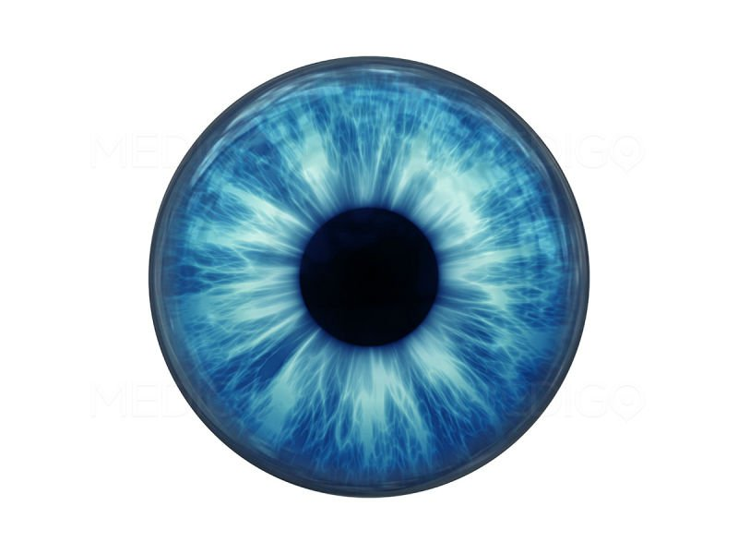
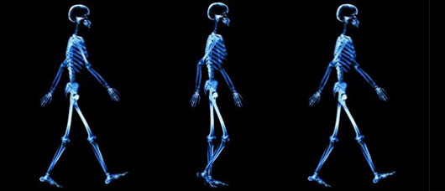
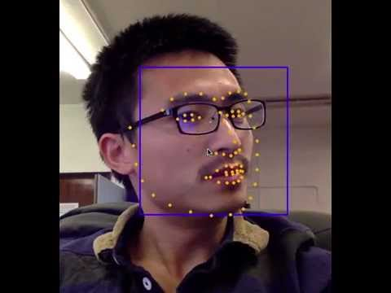
Problem
Biometrical identification – identify and authorize people not by what they remember (passwords) and not by what they bring (keys, smartcards). But by what is an inseparable part of them (iris, fingerprint, gait, DNA, voice …)

Slide 3
Usage
Experience
How many times did you forget passwords of to take card with you? This improves experience.
Multifactor identification
(passport + face, password + SMS, card + pin, card + signature).
More weak classifiers we have, more exactly we identify.

Slide 4
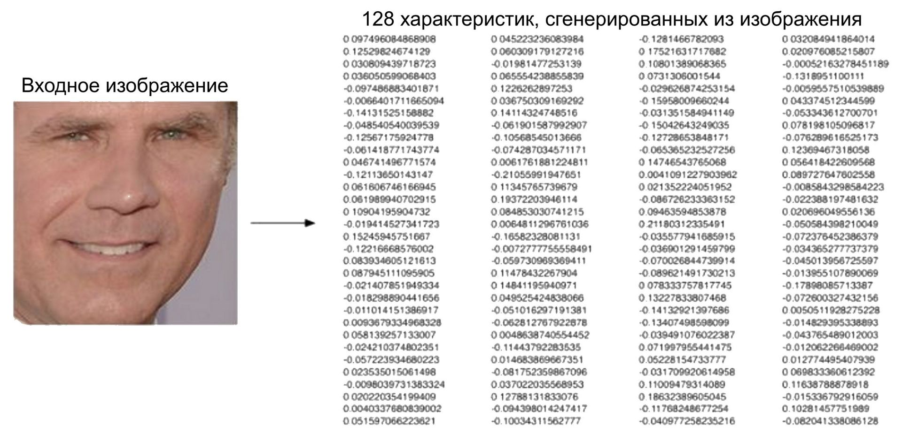
1a. State-of-the-art
1a) We have state of the art solution: reproduce, optimize and build a software upon this solution (authentication system). [DEMO]

Slide 5
1b. Fast and accurate
State-of-the-art solution involves significant resources (deep networks, big feature vectors).
Estimate if we can train a model not on high resolution images, but on some easily computable descriptors (facial landmarks, other precomputed features) to use in embedded devices.
Implement feature extraction
Study and implement classifier
Study and implement general ML pipeline

Slide 6
Test problem. Deadline 10.03
1) You are given MINST (handwritten numbers) dataset. http://yann.lecun.com/exdb/mnist/. Parse and load.
2) Split this data to 80/20 of training/test sets.
3) Implement kNN for symbol classification.
4) Compute accuracy, F₁ score.
5) Find and recognize numbers on these images:
http://www.liveinternet.ru/images/attach/1/3402/3402333_skanirovanie0003.jpg
http://kolyan.net/uploads/posts/2011-02/1296635738_4.jpg
http://pics.livejournal.com/stomaster/pic/0008z0c8/s640x480
http://s00.yaplakal.com/pics/pics_original/9/2/7/2448729.jpg
6) Replace classifier with linear regression. Repeat 3-5.

